Slide 1
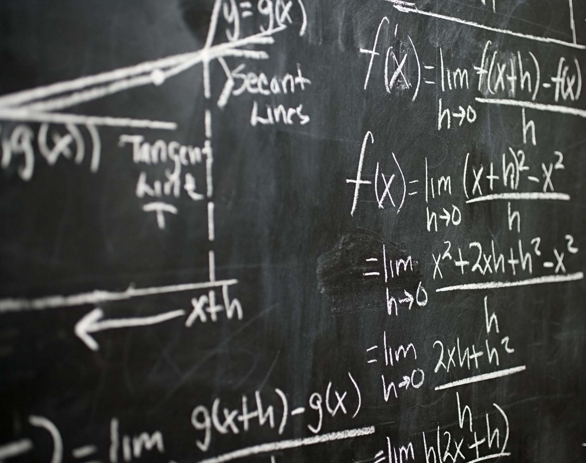
Use AI to transform bureaucratic jargon into plain English: A Holistic Approach to Integrating AI in Government Document Workflows
Guan, Yongzhen & Josiah Watson
07/09/2024

Slide 2
A Holistic Approach to Integrating AI in Government Document Workflows
2. Data Collection and Annotation Process
3. Model Fine-Tuning and Optimization
4. Real-Time Monitoring and Continuous Improvement
LLaMA for on-premise deployment
-Scrapy and BeautifulSoup for data extraction -NLTK and SpaCy for data cleaning -Amazon Mechanical Turk for annotation
-T5 and BART for multi-task learning -Sparse Attention for efficiency -Knowledge Distillation for lightweight model deployment
-Prometheus and Grafana for monitoring -CI/CD Pipelines for automatic updates -Rollback mechanism for stability
Azure OpenAI Service for cloud-based tasks
6. Retrieval-Augmented Generation (RAG) for Accuracy
-Dynamic Spell-Checking (Hunspell) -Localized datasets from Australian archives and media
-BERT Embeddings for data retrieval -Generate-Retrieve-Verify Loop for content validation
5. Ensuring Compliance with Australian English
1. Platform Architecture and Technology Selection
Author: GUAN,Yongzhen; WATSON, Josiah.07/09/2024

Slide 3
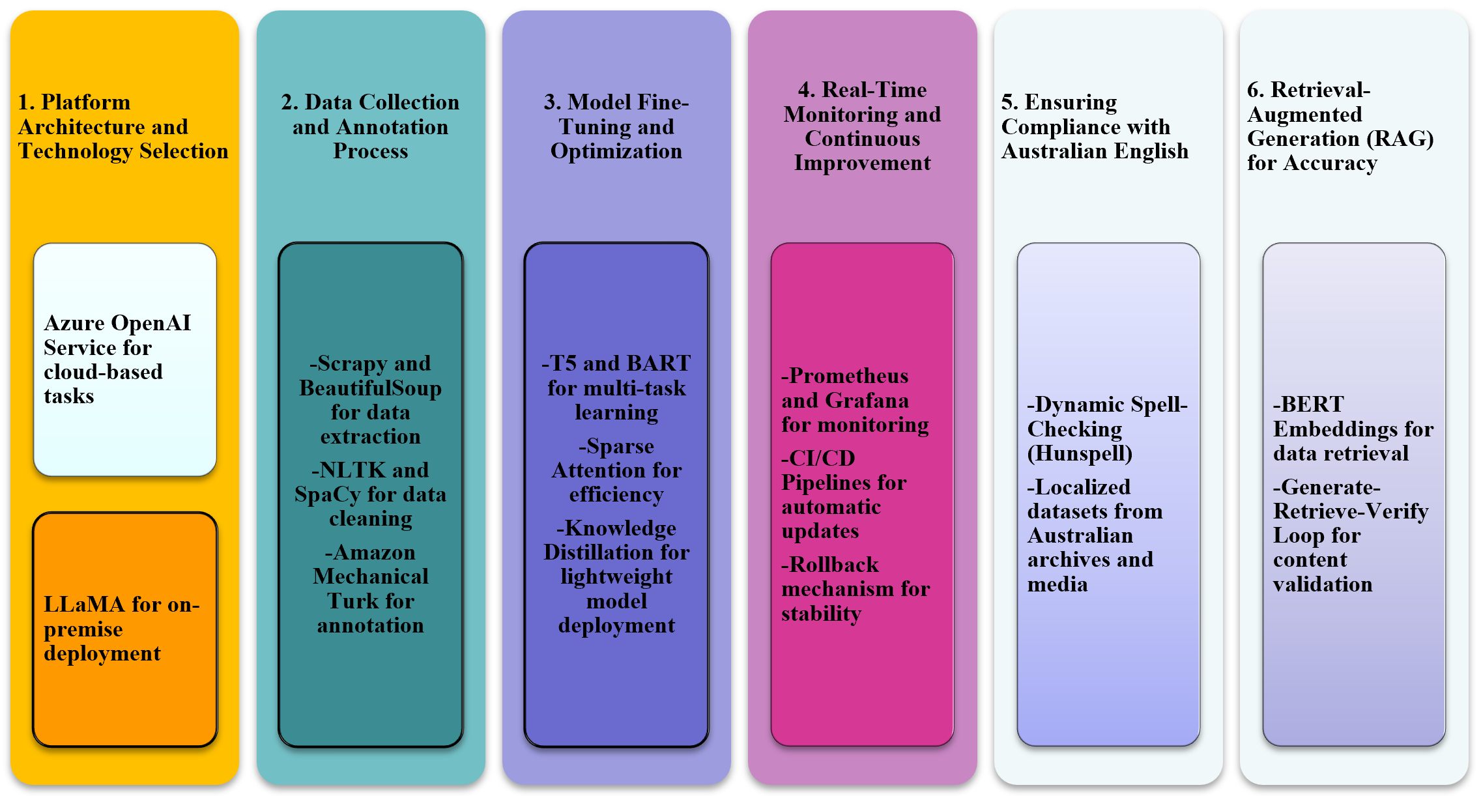
A Holistic Approach to Integrating AI in Government Document Workflows
LLaMA for on-premise deployment
Azure OpenAI Service for cloud-based tasks
1. Platform Architecture and Technology Selection
Author: GUAN,Yongzhen; WATSON, Josiah.07/09/2024

Slide 4
A Holistic Approach to Integrating AI in Government Document Workflows
2. Data Collection and Annotation Process
Scrapy and BeautifulSoup for data extraction
NLTK and SpaCy for data cleaning
Amazon Mechanical Turk for annotation
Author: GUAN,Yongzhen; WATSON, Josiah.07/09/2024

Slide 5
A Holistic Approach to Integrating AI in Government Document Workflows
3. Model Fine-Tuning and Optimization
T5 and BART for multi-task learning
Sparse Attention for efficiency
Knowledge Distillation for lightweight model deployment
Author: GUAN,Yongzhen; WATSON, Josiah.07/09/2024

Slide 6
A Holistic Approach to Integrating AI in Government Document Workflows
4. Real-Time Monitoring and Continuous Improvement
Prometheus and Grafana for monitoring
CI/CD Pipelines for automatic updates
Rollback mechanism for stability
Author: GUAN,Yongzhen; WATSON, Josiah.07/09/2024

Slide 7
A Holistic Approach to Integrating AI in Government Document Workflows
Dynamic Spell-Checking (Hunspell)
5. Ensuring Compliance with Australian English
Localized datasets from Australian archives and media
Author: GUAN,Yongzhen; WATSON, Josiah.07/09/2024

Slide 8
A Holistic Approach to Integrating AI in Government Document Workflows
6. Retrieval-Augmented Generation (RAG) for Accuracy
BERT Embeddings for data retrieval
Generate-Retrieve-Verify Loop for content validation
Author: GUAN,Yongzhen; WATSON, Josiah.07/09/2024

Slide 9
A Holistic Approach to Integrating AI in Government Document Workflows
2. Data Collection and Annotation Process
3. Model Fine-Tuning and Optimization
4. Real-Time Monitoring and Continuous Improvement
LLaMA for on-premise deployment
-Scrapy and BeautifulSoup for data extraction -NLTK and SpaCy for data cleaning -Amazon Mechanical Turk for annotation
-T5 and BART for multi-task learning -Sparse Attention for efficiency -Knowledge Distillation for lightweight model deployment
-Prometheus and Grafana for monitoring -CI/CD Pipelines for automatic updates -Rollback mechanism for stability
Azure OpenAI Service for cloud-based tasks
6. Retrieval-Augmented Generation (RAG) for Accuracy
-Dynamic Spell-Checking (Hunspell) -Localized datasets from Australian archives and media
-BERT Embeddings for data retrieval -Generate-Retrieve-Verify Loop for content validation
5. Ensuring Compliance with Australian English
1. Platform Architecture and Technology Selection
Author: GUAN,Yongzhen; WATSON, Josiah.07/09/2024

